Slide 1
Concurrent Programming with Harmony
Robbert van Renesse

Slide 2
Concurrency Lectures Outline
What are the problems?
no determinism, no atomicity
What is the solution?
some form of mutual exclusion
How to specify concurrent problems?
atomic operations
How to construct correct concurrent code?
behaviors
How to test concurrent programs?
comparing behaviors

Slide 3
Concurrency Lectures Outline
How to build Concurrent Data Structures?
using locks
How to wait for some condition?
using condition variables
How to deal with deadlock?
prevention, avoidance, detection
How to use barrier synchronization?
improve scalability
How to make code interrupt-safe?
enabling/disabling interrupts

Slide 4
The problems

Slide 5
Concurrent Programming is Hard
Why?
Concurrent programs are non-deterministic
run them twice with same input, get two different answers
or worse, one time it works and the second time it fails
Program statements are executed non-atomically
x += 1 compiles to something like
LOAD x
ADD 1
STORE x
with concurrency, this leads to non-deterministic interleavings

Slide 6
Harmony
A new concurrent programming language
heavily based on Python syntax to reduce learning curve for many
A new underlying virtual machine
it tries all possible executions of a program until it finds a problem, if any
(this is called “model checking”)

Slide 7
The problem with non-determinism
sequential
concurrent
What will happen if you run each?

Slide 8
The problem with non-determinism
sequential
concurrent
#states: 2
No issues
Schedule thread T0: init()
Line 1: Initialize shared to True
Thread terminated
Schedule thread T2: g()
Line 4: Set shared to False (was True)
Thread terminated
Schedule thread T1: f()
Line 3: Harmony assertion failed

Slide 9
The problem with non-atomicity
sequential
concurrent
What will happen if you run each?

Slide 10
The problem with non-atomicity
sequential
concurrent
#states: 2
No issues
Schedule thread T1: f()
Preempted in f()
about to store 1 into shared in line 3
Schedule thread T2: f()
Line 3: Set shared to 1 (was 0)
Schedule thread T1: f()
Line 3: Set shared to 1 (unchanged)
Schedule thread T3: finally()
Line 8: Harmony assertion failed

Slide 11
Race Conditions
= timing dependent error involving shared state
A schedule is an interleaving of (i.e., total order on) the machine instructions executed by each thread
Usually, many interleavings are possible
A race condition occurs when at least one interleaving gives an undesirable result

Slide 12
Race Conditions are Hard to Debug
Number of possible interleavings is usually huge
Bad interleavings, if they exist, may happen only rarely
Works 1000x ≠ no race condition
Timing dependent: small changes hide bugs
add print statement → bug no longer seems to happen
Harmony is designed to help identify such bugs
model checking!
Notes:
compiler starts a series of processes. should be allowed.

Slide 13
State Space and Model Checking

Slide 14
Harmony Machine Code
Frame f() Start a new stack frame
Load shared Push shared onto stack
Push 1 Push 1 onto stack
2-ary + Add top two stack elements
Store shared Store top of stack into shared
def f():
shared += 1
compiler

Slide 15
Harmony Virtual Machine State
Three parts:
code (never changes)
values of the shared variables
state of each of the running threads
PC and stack (aka context)
HVM state represents one vertex in a graph of states

Slide 16
State space
Load shared
Push 1
2-ary +
Store shared
thread 1 loads
thread 1 stores
thread 2 loads
thread 2 stores
shared 0
initial state

Slide 17
State space
Load shared
Push 1
2-ary +
Store shared
thread 1 loads
thread 1 stores
thread 2 loads
thread 2 stores
shared 0
A possible execution
L
shared 0
shared 2
S
S
shared 1
shared 1
L

Slide 18
State space
Load shared
Push 1
2-ary +
Store shared
thread 1 loads
thread 1 stores
thread 2 loads
thread 2 stores
Another possible execution
shared 1
shared 0
shared 0
L
L
S
S
shared 0
shared 1

Slide 19
State space
Load shared
Push 1
2-ary +
Store shared
thread 1 loads
thread 1 stores
thread 2 loads
thread 2 stores
shared 0
L
shared 0
All possible states after one “step”
L
shared 0

Slide 20
State space
Load shared
Push 1
2-ary +
Store shared
thread 1 loads
thread 1 stores
thread 2 loads
thread 2 stores
shared 1
S
shared 0
All possible states after two steps
L
L
shared 0
shared 0
L
L
shared 0
S
shared 1

Slide 21
State space
Load shared
Push 1
2-ary +
Store shared
thread 1 loads
thread 1 stores
thread 2 loads
thread 2 stores
L
shared 1
shared 1
S
shared 0
shared 1
L
L
S
shared 0
shared 0
after three steps
L
L
S
shared 0
shared 1
S
shared 1
shared 1
L

Slide 22
State space
Load shared
Push 1
2-ary +
Store shared
thread 1 loads
thread 1 stores
thread 2 loads
thread 2 stores
L
shared 1
shared 1
S
S
shared 0
S
shared 1
shared 1
L
L
S
shared 0
shared 0
L
L
S
S
shared 0
shared 1
shared 2
S
S
shared 1
shared 1
L

Slide 23
Harmony

Slide 24
Harmony != Python
Harmony | Python
tries all possible executions | executes just one
( … ) == [ … ] == … | 1 != [1] != (1)
1, == [1,] == (1,) != (1) == [1] == 1 | [1,] == [1] != (1) == 1 != (1,)
f(1) == f 1 == f[1] | f 1 and f[1] are illegal (if f is method)
no return, break, continue | various flow control escapes
pointers | object-oriented
… | …

Slide 25
I/O in Harmony?
Input:
choose expression
x = choose({ 1, 2, 3 })
allows Harmony to know all possible inputs
const expression
const x = 3
can be overridden with “-c x=4” flag to harmony
Output:
print x + y
assert x + y < 10, (x, y)

Slide 26
I/O in Harmony?
Input:
choose expression
x = choose({ 1, 2, 3 })
allows Harmony to know all possible inputs
const expression
const x = 3
can be overridden with “-c x=4” flag to harmony
Output:
print x + y
assert x + y < 10, (x, y)
No open(), read(), or
or input() statements

Slide 27
Non-determinism in Harmony
Three sources:
choose expressions
thread interleavings
interrupts

Slide 28
Limitation: models must be finite!
shared 1
L
shared 1
S
S
shared 0
shared 1
S
shared 1
L
L
S
shared 0
shared 0
L
L
S
S
shared 0
shared 1
shared 2
S
S
shared 1
shared 1

Slide 29
Limitation: models must be finite!
shared 1
L
shared 1
S
S
shared 0
shared 1
S
shared 1
L
L
S
shared 0
shared 0
L
L
S
S
shared 0
shared 1
shared 2
S
S
shared 1
shared 1
That is, there must be a finite number of states and edges.
But models are allowed to have cycles.
Executions are allowed to be unbounded!
Harmony checks for possibility of termination.

Slide 30
Critical Sections

Slide 31
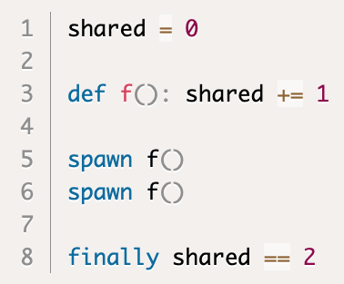
Back to our problem…
2 threads updating a shared variable

Slide 32
Back to our problem…
2 threads updating a shared variable
“Critical Section”

Slide 33
Back to our problem…
2 threads updating a shared variable
“Critical Section”
Goals
Mutual Exclusion: 1 thread in a critical section at time
Progress: a thread can get in when there is no other thread
Fairness: equal chances of getting into CS
… in practice, fairness rarely guaranteed or needed

Slide 34
Mutual Exclusion and Progress
Need both:
either one is trivial to achieve by itself

Slide 35
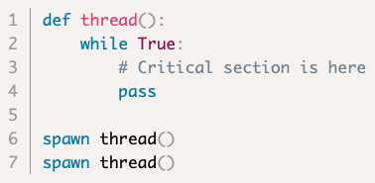
Specifying Critical Sections in Harmony
How do we check mutual exclusion?
How do we check progress?

Slide 36
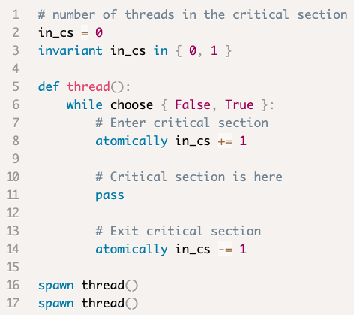
Specifying Critical Sections in Harmony
How do we check mutual exclusion?
How do we check progress?

Slide 37
Specifying Critical Sections in Harmony
mutual exclusion
How do we check mutual exclusion?
How do we check progress?

Slide 38
Specifying Critical Sections in Harmony
mutual exclusion
do zero or more times
How do we check mutual exclusion?
How do we check progress?

Slide 39
Specifying Critical Sections in Harmony
mutual exclusion
do zero or more times
increment in_cs
How do we check mutual exclusion?
How do we check progress?

Slide 40
Specifying Critical Sections in Harmony
mutual exclusion
do zero or more times
increment in_cs
execute critical section
How do we check mutual exclusion?
How do we check progress?

Slide 41
Specifying Critical Sections in Harmony
mutual exclusion
do zero or more times
increment in_cs
execute critical section
decrement in_cs
How do we check mutual exclusion?
How do we check progress?

Slide 42
Specifying Critical Sections in Harmony
mutual exclusion
do zero or more times
increment in_cs
execute critical section
decrement in_cs
Progress: Harmony checks that all thread can terminate

Slide 43
Building a lock is hard

Slide 44
Specification vs implementation
Spec is fine, but we’ll need an implementation too
Sounds like we need a lock
The question is:
How does one build a lock?

Slide 45
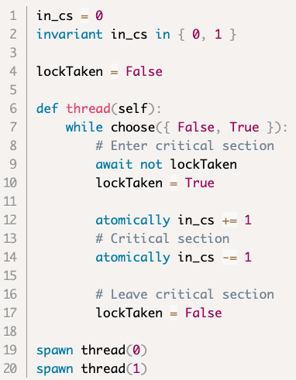
First attempt: a naïve lock

Slide 46
First attempt: a naïve lock
wait till lock is free, then take it

Slide 47
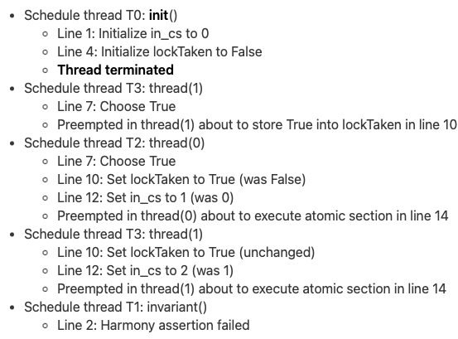
First attempt: a naïve lock

Slide 48
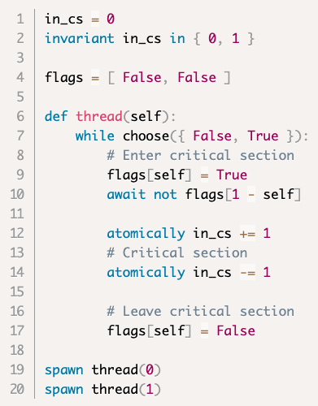
Second attempt: flags

Slide 49
Second attempt: flags
show intent to enter critical section

Slide 50
Second attempt: flags
show intent to enter critical section
wait until there’s no one else

Slide 51
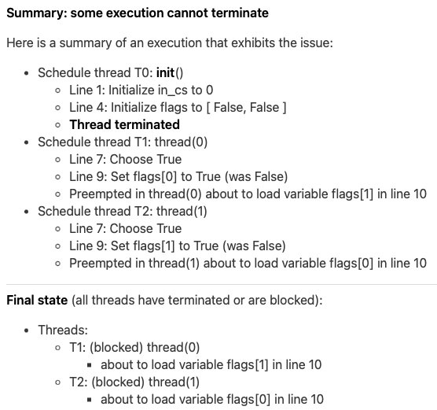
Second attempt: flags

Slide 52
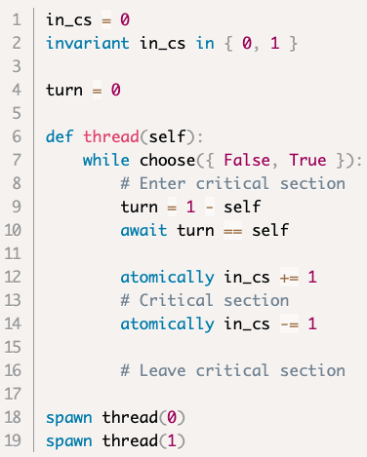
Third attempt: turn variable

Slide 53
Third attempt: turn variable
after you...

Slide 54
Third attempt: turn variable
after you...
wait for your turn

Slide 55
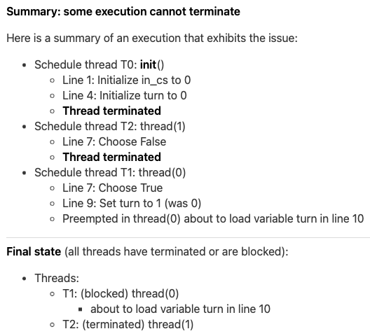
Third attempt: turn variable

Slide 56
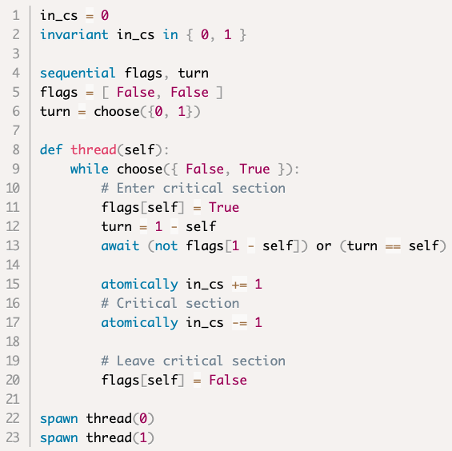
Peterson’s Algorithm: flags & turn

Slide 57
Peterson’s Algorithm: flags & turn
in critical section

Slide 58
Peterson’s Algorithm: flags & turn
load and store instructions are atomic
in critical section

Slide 59
Peterson’s Algorithm: flags & turn
load and store instructions are atomic
uses flags and turn variable (3 bits total)
in critical section

Slide 60
Peterson’s Algorithm: flags & turn
load and store instructions are atomic
uses flags and turn variable (3 bits total)
first indicate intention to enter critical section
in critical section
no longer in critical section

Slide 61
Peterson’s Algorithm: flags & turn
load and store instructions are atomic
uses flags and turn variable (3 bits total)
first indicate intention to enter critical section
also give other thread a turn first
in critical section
no longer in critical section

Slide 62
Peterson’s Algorithm: flags & turn
load and store instructions are atomic
uses flags and turn variable (3 bits total)
first indicate intention to enter critical section
also give other thread a turn first
wait for one of either conditions
in critical section
no longer in critical section

Slide 63
Proving a concurrent program correct

Slide 64
So, we proved Peterson’s Algorithm correct by brute force, enumerating all possible executions. We now know that it works.
But how does one prove it by deduction?
so one understands why it works…

Slide 65
What and how?
Need to show that, for any execution, all states reached satisfy mutual exclusion
in other words, mutual exclusion is invariant
invariant = predicate that holds in every reachable state

Slide 66
What is an invariant?
A property that holds in all reachable states
(and possibly in some unreachable states as well)
What is a property?
A property is a set of states
often succinctly described using a predicate
(all states that satisfy the predicate and no others)

Slide 67
Invariant Property
initial state
Reachable States
Invariant Property
All States

Slide 68
Invariant Property
initial state
States in which mutual exclusion holds
Reachable States
Invariant Property
All States

Slide 69
Invariant Property
initial state
States in which mutual exclusion holds
Reachable States
Includes states where mutual exclusion is violated
Invariant Property
All States

Slide 70
How to prove an invariant?
Need to show that, for any execution, all states reached satisfy the invariant
Sounds similar to sorting:
Need to show that, for any list of numbers, the resulting list is ordered
Let’s try proof by induction on the length of an execution

Slide 71
Proof by induction
You want to prove that some Induction Hypothesis IH(n) holds for any n:
Base Case:
show that IH(0) holds
Induction Step:
show that if IH(i) holds, then so does IH(i+1)

Slide 72
Proof by induction in our case
To show that some IH holds for an execution E of any number of steps:
Base Case:
show that IH holds in the initial state(s)
Induction Step:
show that if IH holds in a state produced by E, then for any possible next step s, IH also holds in the state produced by E + [s]

Slide 73
Example
Theorem: if T is in the critical section, then flags[T] = True
Base case: true because initially T is not in the critical section and False implies anything
Induction: easy to show (using Hoare logic) because flags[T] can only be changed by T itself

Slide 74
Data Races

Slide 75
Peterson’s Reconsidered
Assumes that LOAD and STORE instructions are atomic
Not guaranteed on a real processor
Also not guaranteed by C, Java, Python, …
Loads and Stores are atomic

Slide 76
For example
CPU with 16-bit architecture
32-bit integer variable x stored in memory in two adjacent locations (aligned on word boundary)
Initial value is 0
Thread 1 writes FFFFFFFF to x (requires 2 STOREs)
Thread 2 reads x (requires 2 LOADs)
What are the possible values that thread 2 will read?

Slide 77
For example
CPU with 16-bit architecture
32-bit integer variable x stored in memory in two adjacent locations (aligned on word boundary)
Initial value is 0
Thread 1 writes FFFFFFFF to x (requires 2 STOREs)
Thread 2 reads x (requires 2 LOADs)
What are the possible values that thread 2 will read?
FFFFFFFF
00000000
FFFF0000
0000FFFF

Slide 78
Other examples
In Python, integers are arbitrary precision
that is, each integer variable is a complex data structure, and an operation may require multiple loads and stores
Suppose your C compiler decides to pack multiple bits in a single word
E.g., flags[0], flags[1], and turn
Then setting a bit involves a load and a store

Slide 79
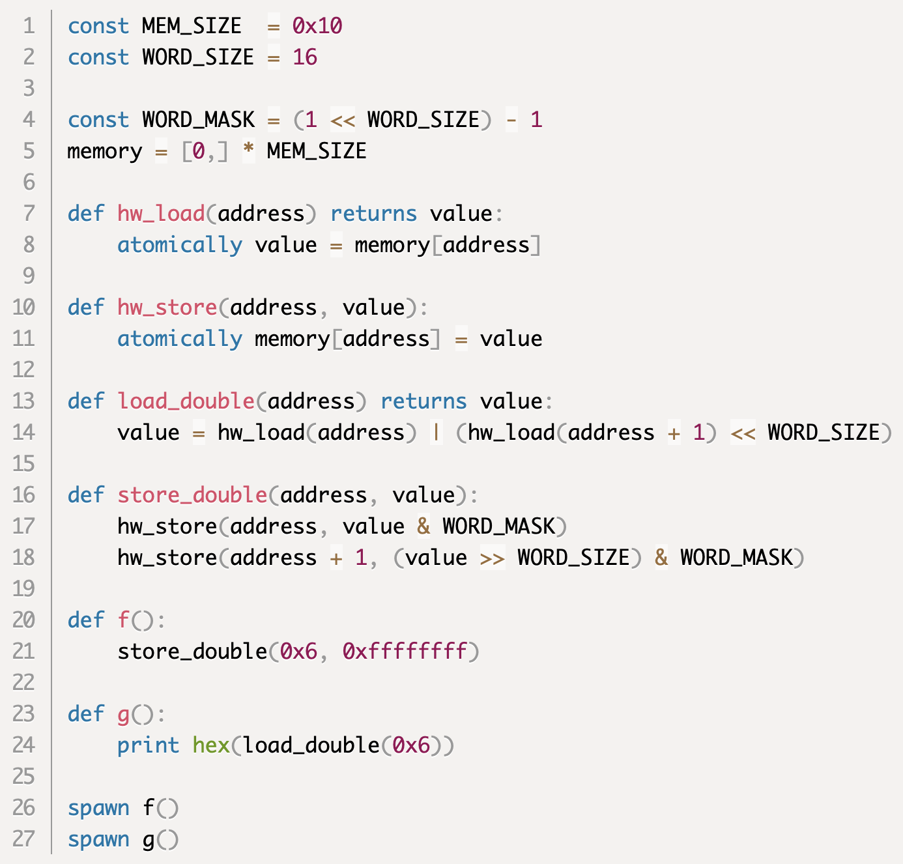
Example modeled in Harmony

Slide 80
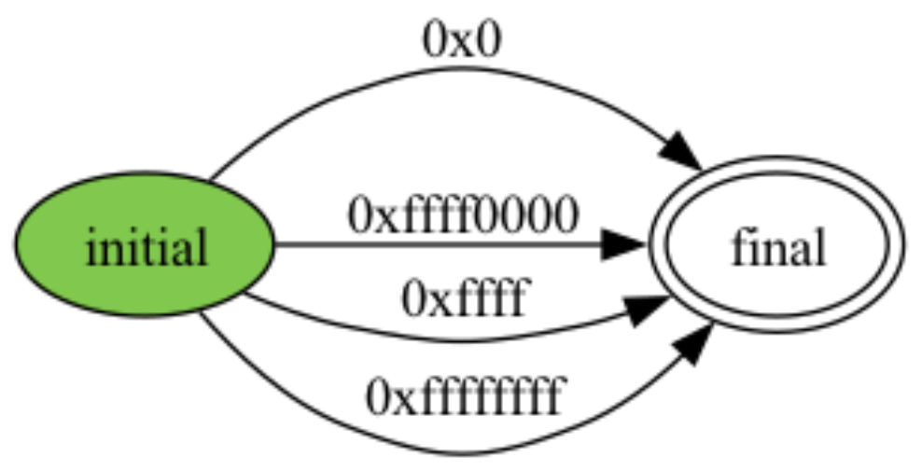
Example modeled in Harmony

Slide 81
Concurrent memory access
Hardware may also cause problems in efforts to improve performance
buffering of writes
caching of reads
out-of-order execution
Because of all these issues, programming languages will typically leave the outcome of concurrent operations to a variable undefined
if at least one of those operations is a store

Slide 82
Data Race
When two or more threads wish to access the same variable at the same time
And at least one access is a STORE
Then the semantics of the outcome is undefined
That is:
The value stored in the variable is undefined
The value loaded (if any) is undefined
Undefined means random (or worse, like a crash)

Slide 83
Harmony “sequential” statement
sequential turn, flags in Peterson’s
ensures that loads/stores are atomic
that is, concurrent operations appear to be executed sequentially
This is called “sequential consistency”
For example
Shared variable x contains 3
Thread A stores 4 into x
Thread B loads x
With atomic load/store operations, B will read either 3 or 4
With normal operations, the value that B reads is undefined

Slide 84
Sequential consistency
Java has a similar notion:
volatile int x ;
All accesses to volatile variables are sequentially consistent (but not whole program)
Not to be confused with the same keyword in C and C++ though…
Loading/storing volatile (sequentially consistent) variables is more expensive than loading/storing ordinary variables
because it restricts CPU and/or compiler optimizations
e.g., rules out caching

Slide 85
Peterson’s Reconsidered Again
Peterson’s algorithm is correct with atomic LOAD and STORE instructions
hardware supports such instructions but they are very expensive
Peterson’s can be generalized to >2 processes
even more STOREs and LOADs
Too inefficient in practice

Slide 86
Specifying a lock

Slide 87
Back to basics: specifying a lock
What does a lock do exactly?
What if we want more than one?

Slide 88
Harmony interlude: pointers
If x is a shared variable, ?x is the address of x
If p is a variable and p contains ?x, then we say that p is a pointer and it points to x
Finally, !p refers to the value of x
Where?
There!

Slide 89
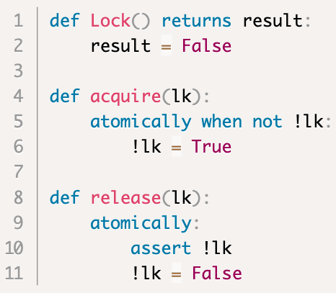
Specifying a lock

Slide 90
Specifying a lock
returns initial value
acquires lock atomically once available
releases lock atomically

Slide 91
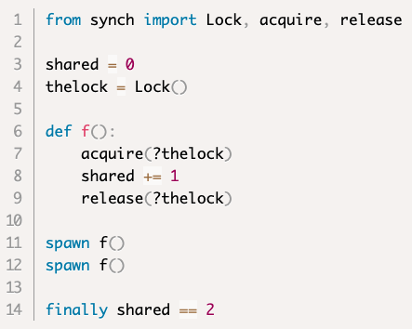
Critical Section using a lock

Slide 92
Critical Section using a lock
Contains Lock spec

Slide 93
“Ghost” state
We say that a lock is held or owned by a thread
implicit “ghost” state (not an actual variable)
nonetheless can be used for reasoning
Two important invariants:
$T@CriticalSection⇒T$ holds the lock
at most one thread can hold the lock
Together guarantee mutual exclusion
Many (most?) systems do not keep track of who holds a particular lock, if anybody

Slide 94
Implementing a lock

Slide 95
Implementing a lock
We saw that it is hard and inefficient to implement a lock with just LOAD and STORE instructions

Slide 96
Enter Interlock Instructions
Machine instructions that do multiple shared memory accesses atomically
e.g., test_and_set s
sets s to True
returns old value of s
i.e., does the following:
LOAD r0, s # load variable s into register r0
STORE s, 1 # store TRUE in variable s
Entire operation is atomic
other machine instructions cannot interleave

Slide 97
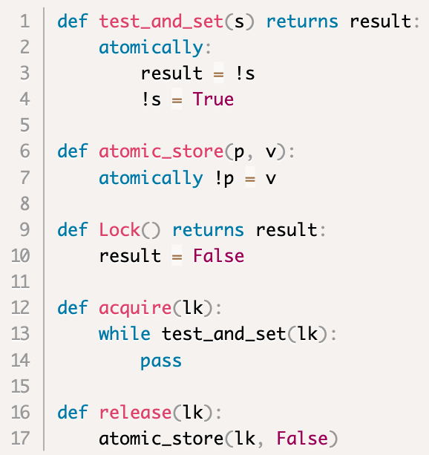
Lock implementation (“spinlock”)
specification of the CPU’s
test_and_set functionality
specification of the CPU’s
atomic store functionality
lock implementation

Slide 98
Specification vs Implementation
Specification: describes what an abstraction does
Implementation: describes how
fine line

Slide 99
Spinlocks and Time Sharing
Spinlocks work well when threads on different cores need to synchronize
But how about when it involves two threads time-shared on the same core:
when there is no pre-emption?
when there is pre-emption?

Slide 100
Spinlocks and Time Sharing
Spinlocks work well when threads on different cores need to synchronize
But how about when it involves two threads time-shared on the same core:
when there is no pre-emption?
can cause all threads to get stuck while one is trying to obtain a spinlock
when there is pre-emption?

Slide 101
Spinlocks and Time Sharing
Spinlocks work well when threads on different cores need to synchronize
But how about when it involves two threads time-shared on the same core:
when there is no pre-emption?
can cause all threads to get stuck while one is trying to obtain a spinlock
when there is pre-emption?
can cause delays and waste of CPU cycles while a thread is trying to obtain a spinlock

Slide 102
Context switching in Harmony
Harmony allows contexts to be saved and restored (i.e., context switch)
r = stop p
stops the current thread and stores context in !p
go (!p) r
adds a thread with the given context to the bag of threads. Thread resumes from stop expression, returning r

Slide 103
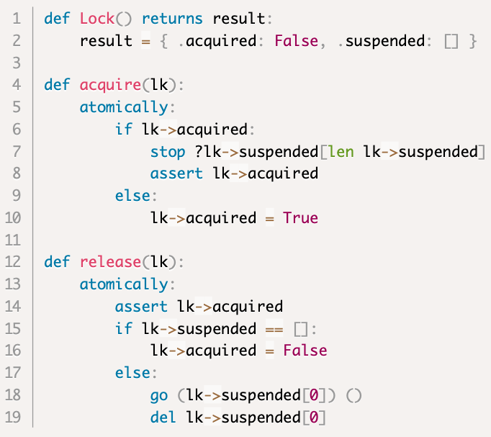
Locks using stop and go
.acquired: boolean
.suspended: queue of contexts

Slide 104
Locks using stop and go
.acquired: boolean
.suspended: queue of contexts
put thread on wait queue
resume first thread on wait queue

Slide 105
Locks using stop and go
Similar to a Linux “futex”: if there is no contention (hopefully the common case) acquire() and release() are cheap. If there is contention, they involve a context switch.

Slide 106
Choosing modules in Harmony
“synch” is the (default) module that has the specification of a lock
“synchS” is the module that has the stop/go version of lock
you can select which one you want:
harmony -m synch=synchS x.hny
“synch” tends to be faster than “synchS”
smaller state graph

Slide 107
Atomic Section $≠$ Critical Section
Atomic Section | Critical Section
only one thread can execute | multiple threads can execute concurrently, just not within a critical section
rare programming language paradigm | ubiquitous: locks available in many mainstream programming languages
good for specifying interlock instructions | good for implementing concurrent data structures

Slide 108
Data Race $≠$ Race Condition
A Data Race occurs when two threads try to access the same variable and at least one access is non-atomic and at least one access is an update.
The outcome of the operations is undefined
A Race Condition occurs when the correctness of the program depends on ordering of variable access
Race Condition can happen without a Data Race

Slide 109
Data Race $≠$ Race Condition
Data Race: Harmony can automatically detect these because Harmony enumerates all behaviors and fails if there is undefined behavior
Race Condition: Harmony can only detect these if you tell Harmony what it is that you want using assert, invariant, or finally
or by explicitly enumerating the correct behaviors, as we’ll see later

Slide 110
Demo Time

Slide 111
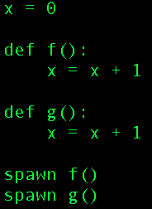
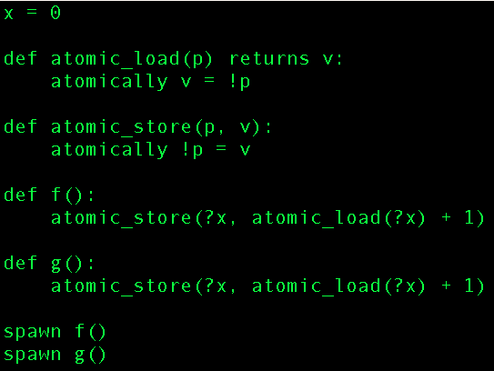
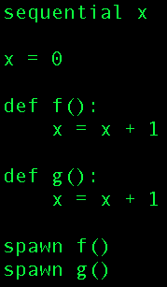
Harmony demo
Demo 3: same semantics as Demo 2:
Demo 1: data race
Demo 2: no data race

Slide 112
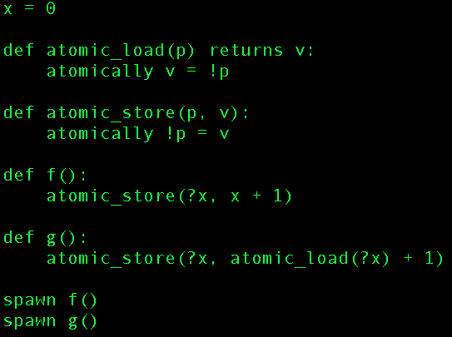
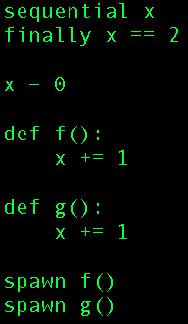
Harmony demo
Demo 5: data race freedom does not imply no race conditions
Demo 4: still a data race

Slide 113
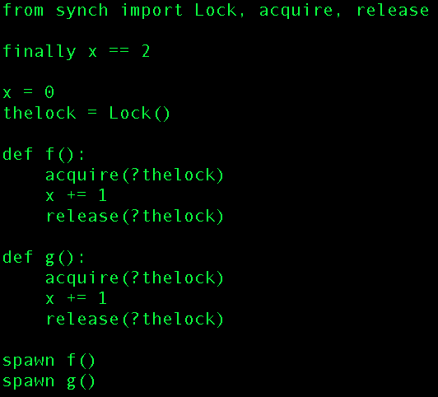
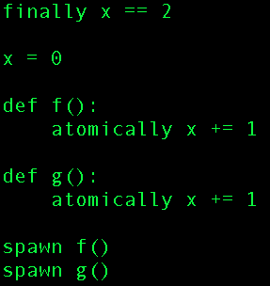
Harmony demo
Demo 7: implementation using critical section
Demo 6: spec of what we want

Slide 114
Harmony demo
Demo 8: broken implementation using two critical sections

Slide 115
Concurrent Data Structure Consistency

Slide 116
Data Structure consistency
Each data structure maintains some consistency property
e.g., in a linked list, there is a head, a tail, a list of nodes such that head points to first node, tail points to the last node, and each node points to the next one except the last, which points to None. However, if the list is empty, head and tail are both None.
.head
.tail
.lock
.value
.next
.value
.next
.value
.next
None

Slide 117
Consistency using locks
Each data structure maintains some consistency property
e.g., in a linked list, there is a head, a tail, a list of nodes such that head points to first node, tail points to the last node, and each node points to the next one except the last, which points to None. However, if the list is empty, head and tail are both None.
You can assume the property holds right after obtaining the lock
You must make sure the property holds again right before releasing the lock

Slide 118
Consistency using locks
Each data structure maintains some consistency property
Invariant:
lock not held $⟹$ data structure consistent
Or equivalently:
data structure inconsistent $⟹$lock held

Slide 119
Building a concurrent queue
q = queue.Queue(): initialize a new queue
queue.put(q, v): add v to the tail of queue q
v = queue.get(q): returns None if q is empty or v if v was at the head of the queue

Slide 120
How important are concurrent queues?
Answer: all important
any resource that needs scheduling
CPU run queue
disk, network, printer waiting queue
lock waiting queue
inter-process communication
Posix pipes:
cat file | tr a-z A-Z | grep RVR
actor-based concurrency
…

Slide 121
How important are concurrent queues?
Answer: all important
any resource that needs scheduling
CPU run queue
disk, network, printer waiting queue
lock waiting queue
inter-process communication
Posix pipes:
cat file | tr a-z A-Z | grep RVR
actor-based concurrency
…
Good performance is critical!

Slide 122
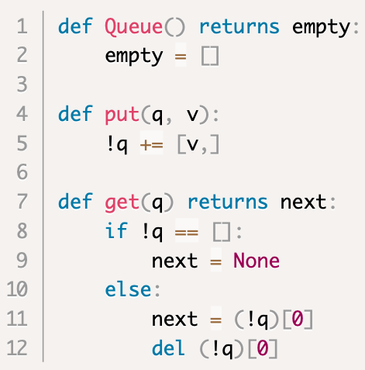
Specifying a concurrent queue

Slide 123
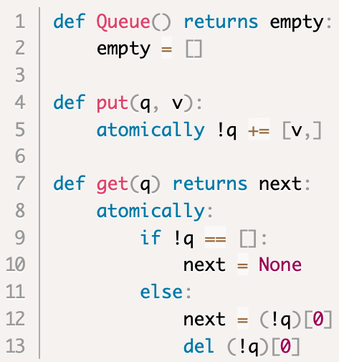
Specifying a concurrent queue
Sequential
Concurrent

Slide 124
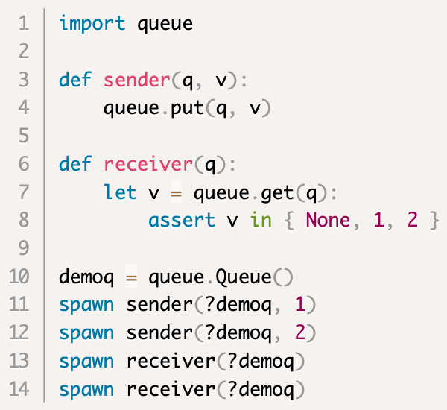
Example of using a queue
enqueue v onto !q
dequeue and check
create queue

Slide 125
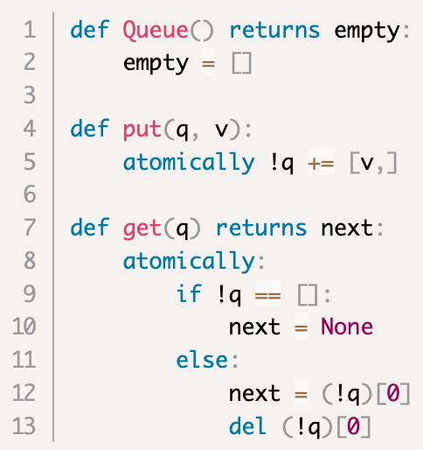
Specifying a concurrent queue
Not a good implementation because
operations are O(n)
code uses atomically
compiler cannot generate code

Slide 126
Implementing a concurrent queue

Slide 127
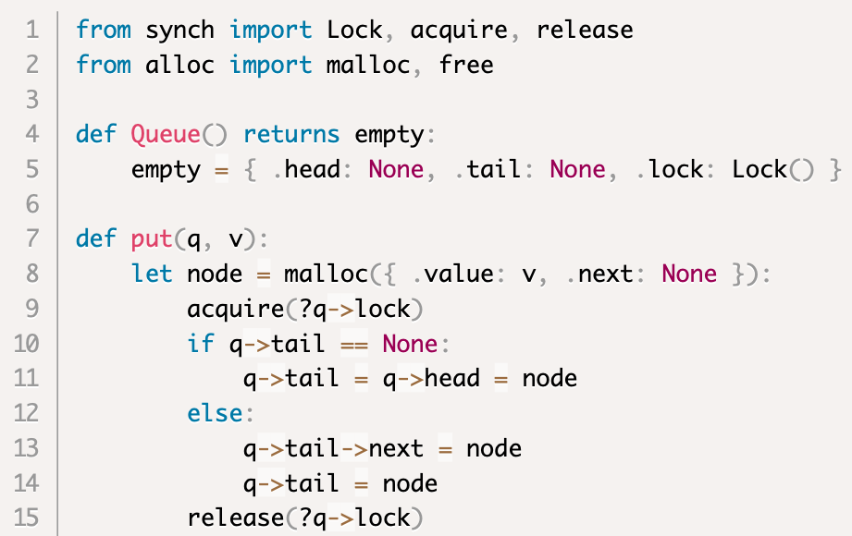
Queue implementation, v1
.head
.tail
.lock
.value
.next
.value
.next
.value
.next
None

Slide 128
Queue implementation, v1
.head
.tail
.lock
.value
.next
.value
.next
.value
.next
None
dynamic memory allocation

Slide 129
Queue implementation, v1
.head
.tail
.lock
.value
.next
.value
.next
.value
.next
None
empty queue

Slide 130
Queue implementation, v1
.head
.tail
.lock
.value
.next
.value
.next
.value
.next
None
allocate node

Slide 131
Queue implementation, v1
.head
.tail
.lock
.value
.next
.value
.next
.value
.next
None
grab lock

Slide 132
Queue implementation, v1
.head
.tail
.lock
.value
.next
.value
.next
.value
.next
None
the hard stuff

Slide 133
Queue implementation, v1
.head
.tail
.lock
.value
.next
.value
.next
.value
.next
None
release lock

Slide 134
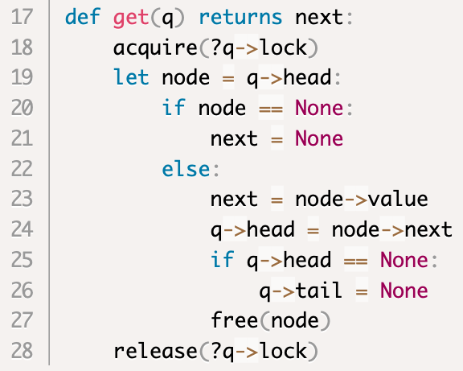
Queue implementation, v1
.head
.tail
.lock
.value
.next
.value
.next
.value
.next
None

Slide 135
Queue implementation, v1
.head
.tail
.lock
.value
.next
.value
.next
.value
.next
None
the hard stuff

Slide 136
Queue implementation, v1
.head
.tail
.lock
.value
.next
.value
.next
.value
.next
None
malloc’d memory must be explicitly released (cf. C)

Slide 137
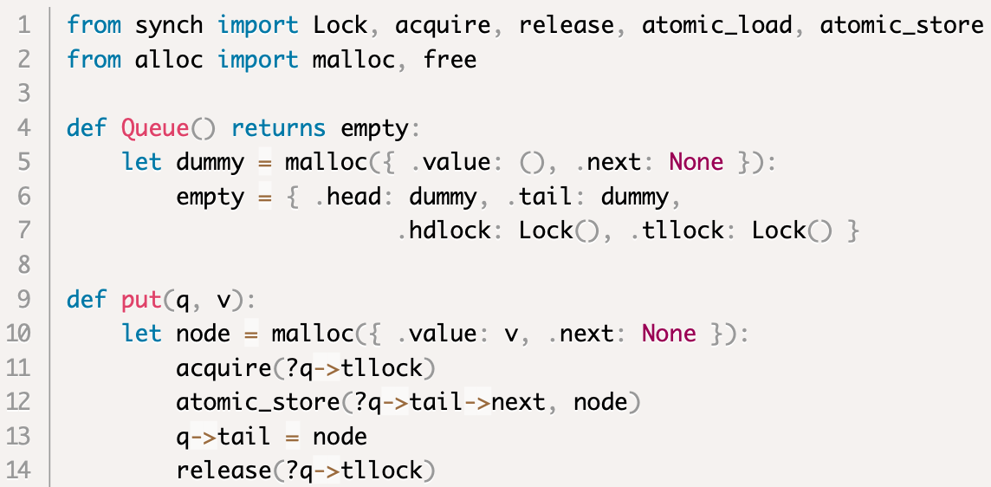
Concurrent queue v2: 2 locks
.head
.tail
.hdlock
.tllock
dummy
.value
.next
.value
.next
.value
.next
None

Slide 138
Concurrent queue v2: 2 locks
.head
.tail
.hdlock
.tllock
dummy
.value
.next
.value
.next
.value
.next
None
atomically q->tail->next = node

Slide 139
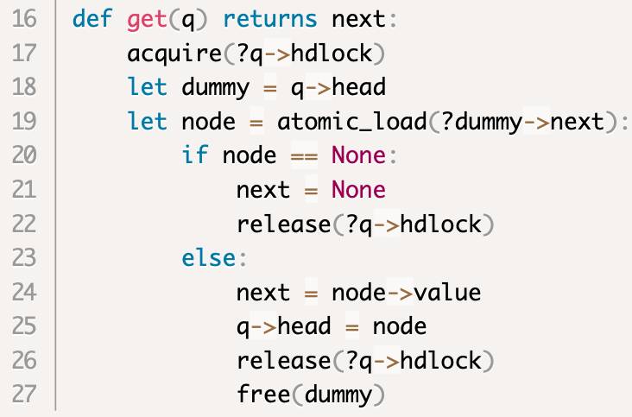
Concurrent queue v2: 2 locks
.head
.tail
.hdlock
.tllock
dummy
.value
.next
.value
.next
.value
.next
None

Slide 140
Concurrent queue v2: 2 locks
.head
.tail
.hdlock
.tllock
dummy
.value
.next
.value
.next
.value
.next
None
No contention for concurrent enqueue and dequeue operations! ➔ more concurrency ➔ faster

Slide 141
Concurrent queue v2: 2 locks
.head
.tail
.hdlock
.tllock
dummy
.value
.next
.value
.next
.value
.next
None
No contention for concurrent enqueue and dequeue operations! ➔ more concurrency ➔ faster
Needs to avoid data race on dummy→next when queue is empty

Slide 142
Fine-Grained Locking

Slide 143
Global vs. Local Locks
The two-lock queue is an example of a data structure with finer-grained locking
A global lock is easy, but limits concurrency
Fine-grained or local locking can improve concurrency, but tends to be trickier to get right

Slide 144
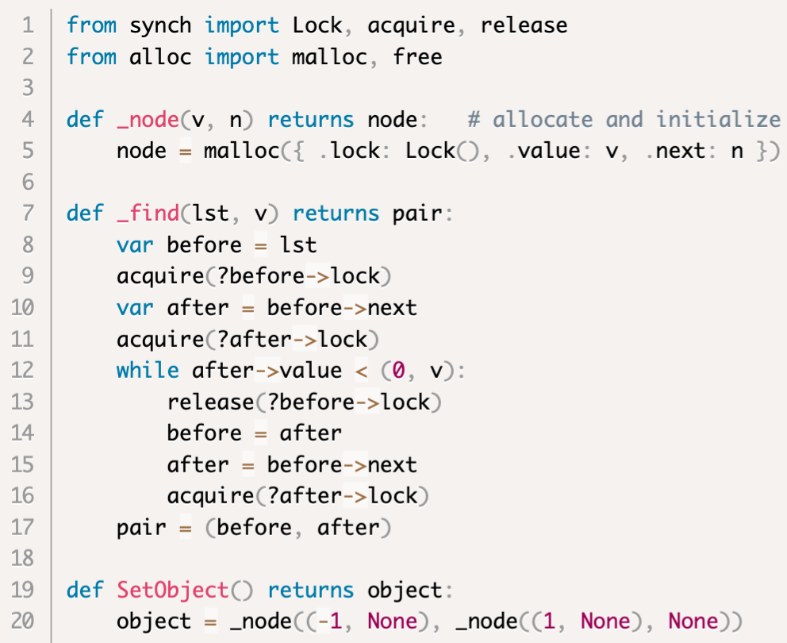
Sorted Linked List with Lock per Node
$$−∞$$
.next
.value
.next
.value
.next
$$∞$$
.next
None
$−∞$represented by (-1, None)
v represented by (0, v)
$∞$represented by (1, None)
Note that $∀\text{v}$: (-1, None) < (0, v) < (1, None)
(lexicographical ordering)
empty list

Slide 145
Sorted Linked List with Lock per Node
$$−∞$$
.next
.value
.next
.value
.next
$$∞$$
.next
None
Helper routine to find and lock two consecutive nodes before and after such that
before $→value< v≤after →value$

Slide 146
Sorted Linked List with Lock per Node
$$−∞$$
.next
.value
.next
.value
.next
$$∞$$
.next
None
Helper routine to find and lock two consecutive nodes before and after such that
before $→value< v≤after →value$
Hand-over hand locking
(good for data structures without cycles)

Slide 147
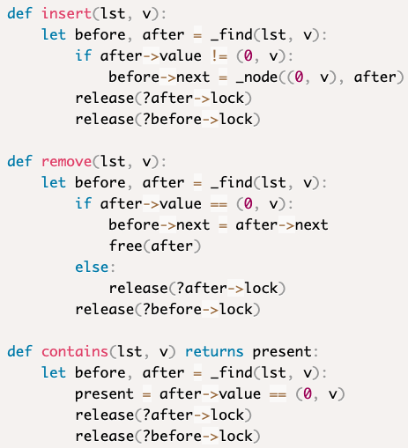
Sorted Linked List with Lock per Node

Slide 148
Sorted Linked List with Lock per Node
Multiple threads can access the list simultaneously, but they can’t overtake one another

Slide 149
Systematic Testing

Slide 150
Systematic Testing
Sequential case
try all “sequences” of 1 operation
put or get (in case of queue)
try all sequences of 2 operations
put+put, put+get, get+put, get+get, …
try all sequences of 3 operations
…
How do you know if a sequence is correct?
compare “behaviors” of running test against implementation with running test against the sequential specification

Slide 151
Systematic Testing
Concurrent case
try all “interleavings” of 1 operation
try all interleavings of 2 operations
try all interleavings of 3 operations
…
How do you know if an interleaving is correct?
compare “behaviors” of running test against concurrent implementation with running test against the concurrent specification

Slide 152
Life of an atomic operation
process invokes operation
operation happens atomically
process resumes with result
TIME

Slide 153
Concurrency and Overlap
Is the following a possible scenario?
customer X orders a burger
customer Y orders a burger (afterwards)
customer Y is served a burger
customer X is served a burger (afterwards)

Slide 154
Concurrency and Overlap
Is the following a possible scenario?
customer X orders a burger
customer Y orders a burger (afterwards)
customer Y is served a burger
customer X is served a burger (afterwards)
We’ve all seen this happen. It’s a matter of how things get scheduled!

Slide 155
Specification
One operation: order a burger
result: a burger (at some later time)
Semantics: the burger manifests itself atomically sometime during the operation
Atomically: no two manifestations overlap
It’s easier to specify something when you don’t have to worry about overlap
i.e., you can simply give a sequential specification
Allows many implementations

Slide 156
Implementation?
Suppose the diner has one small hot plate and two cooks
Cooks use a lock for access to the hot plate
Possible scenario:
customer X orders burger, order ends up with cook 1
customer Y orders burger, order ends up with cook 2
cook 1 was busy with something else, so cook 2 grabs the lock first
cook 2 cooks burger for Y
cook 2 releases lock
cook 1 grabs lock
cook 1 cooks burger for X
cook 1 releases lock
customer Y receives burger
customer X receives burger
X:
1
Y:
2

Slide 157
Implementation?
Suppose the diner has one small hot plate and two cooks
Cooks use a lock for access to the hot plate
Possible scenario:
customer X orders burger, order ends up with cook 1
customer Y orders burger, order ends up with cook 2
cook 1 was busy with something else, so cook 2 grabs the lock first
cook 2 cooks burger for Y
cook 2 releases lock
cook 1 grabs lock
cook 1 cooks burger for X
cook 1 releases lock
customer Y receives burger
customer X receives burger
X:
1
Y:
2
can’t happen if Y orders burger after X receives burger
but if operations overlap, any ordering can happen…

Slide 158
Correct Behaviors
put(1)
(1)
get() → ?
TIME

Slide 159
Correct Behaviors
put(1)
(1)
get() → 1
TIME

Slide 160
Correct Behaviors
put(1)
(1)
get() → 1
put(1)
(2)
get() → ?
TIME

Slide 161
Correct Behaviors
put(1)
(1)
get() → 1
put(1)
(2)
get() → None
TIME

Slide 162
Correct Behaviors
put(1)
(1)
get() → 1
put(1)
(2)
get() → None
TIME
put(1)
(3)
get() → ???

Slide 163
Correct Behaviors
put(1)
(1)
get() → 1
put(1)
(2)
get() → None
TIME
put(1)
(3)
get() → None

Slide 164
Correct Behaviors
put(1)
(1)
get() → 1
put(1)
(2)
get() → None
TIME
put(1)
(3)
get() → 1

Slide 165
Testing Concurrent Objects
Concurrent case
try all “interleavings” of 1 operation
try all interleavings of 2 operations
try all interleavings of 3 operations
…
How do you know if an interleaving is correct?
compare “behaviors” of running test against concurrent implementation with running test against the concurrent specification

Slide 166
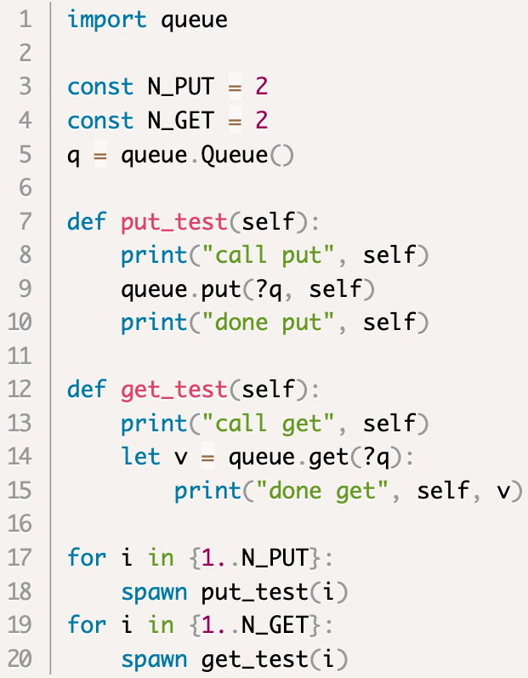
Concurrent queue test program

Slide 167
Behavior (1 get, 1 put)
$ harmony -c N_GET=1 –c N_PUT=1 -o spec.png code/queue_btest1.hny

Slide 168
Testing: comparing behaviors
The first command outputs the behavior of running the test program against the specification in file queue4.hfa
The second command runs the test program against the implementation and checks if its behavior matches that stored in queue4.hfa

Slide 169
Black Box Testing
Not allowed to look under the covers
can’t use rw->nreaders, etc.
Only allowed to invoke the interface methods and observe behaviors
Your job: try to find bad behaviors
compare against a specification
how would you test a clock? An ATM machine?
In general testing cannot ensure correctness
only a correctness proof can
testing may or may not expose a bug
model checking helps expose bugs

Slide 170
Conditional Waiting

Slide 171
Review
Concurrent Programming is Hard!
Non-Determinism
Non-Atomicity
Critical Sections simplify things by avoiding data races
mutual exclusion
progress
Need both mutual exclusion and progress!
Critical Sections use a lock
Thread needs lock to enter the critical section
Only one thread can get the section’s lock

Slide 172
Conditional Waiting
Thus far we’ve shown how threads can wait for one another to avoid multiple threads in the critical section
Sometimes there are other reasons:
Wait until queue is non-empty
Wait until there are no readers (or writers) in a reader/writer lock
…

Slide 173
Reader/writer lock
Idea: allow multiple read-only operations to execute concurrently
Still no data races
In many cases, reads are much more frequent than writes
➔Either:
multiple readers, or
a single writer
thus not:
a reader and a writer, nor
multiple writers

Slide 174
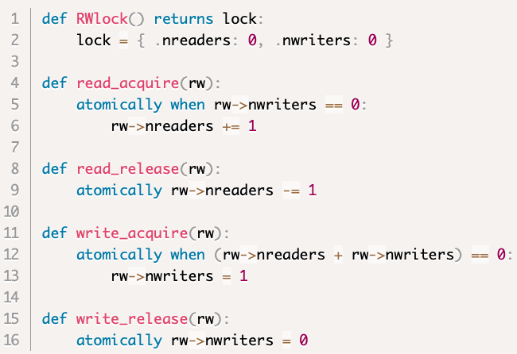
Reader/Writer Lock Specification

Slide 175
Reader/Writer Lock Specification
Invariants:
if $n$ readers in the R/W critical section, then $nreaders≥n$
if $n$ writers in the R/W critical section, then $nwriters≥n$
$\left(nreaders≥0∧nwriters=0\right)∨(nreaders=0∧0≤nwriters≤$ 1)

Slide 176
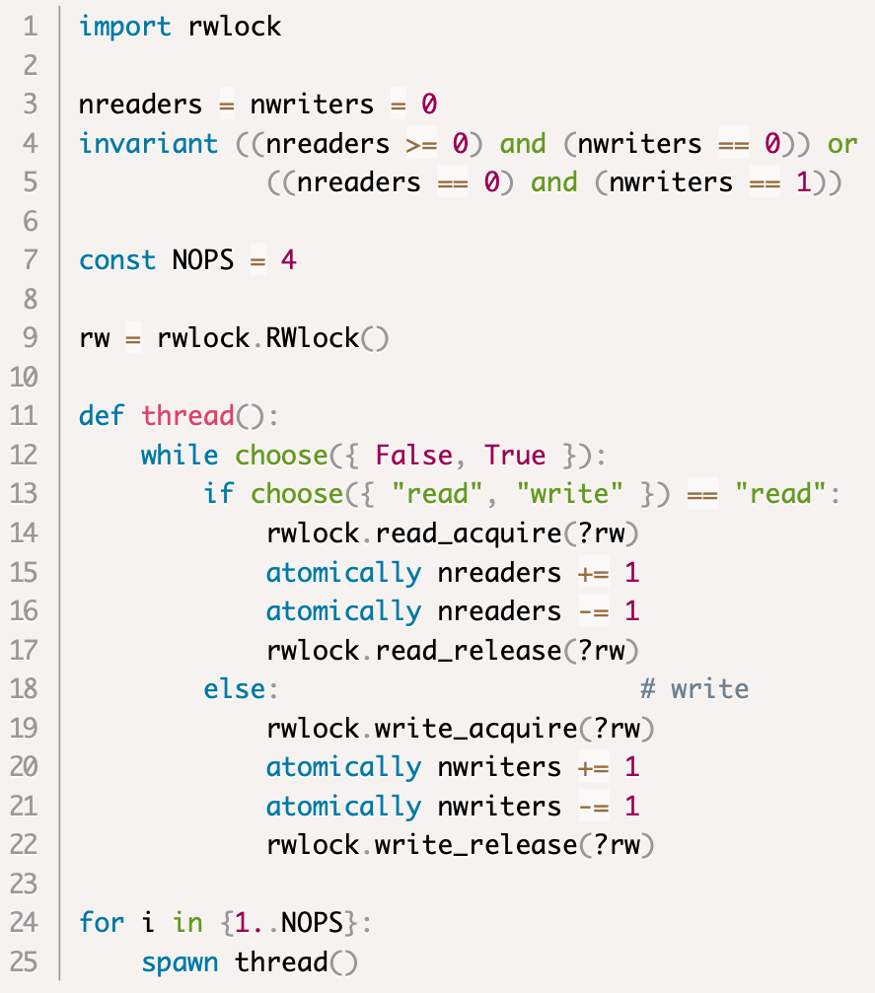
R/W Locks: test for mutual exclusion
no writer, one or more readers
one writer, no readers

Slide 177
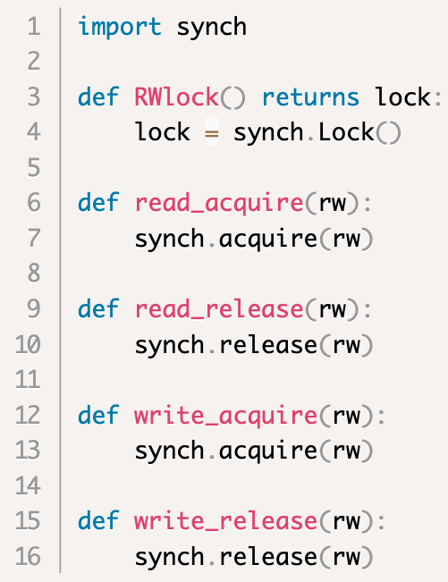
Cheating R/W lock implementation
The lock protects the application’s critical section

Slide 178
Cheating R/W lock implementation
The lock protects the application’s critical section
Allows only one reader to get the lock at a time
Does not have the same behavior as the specification
it is missing behaviors
no bad behaviors though

Slide 179
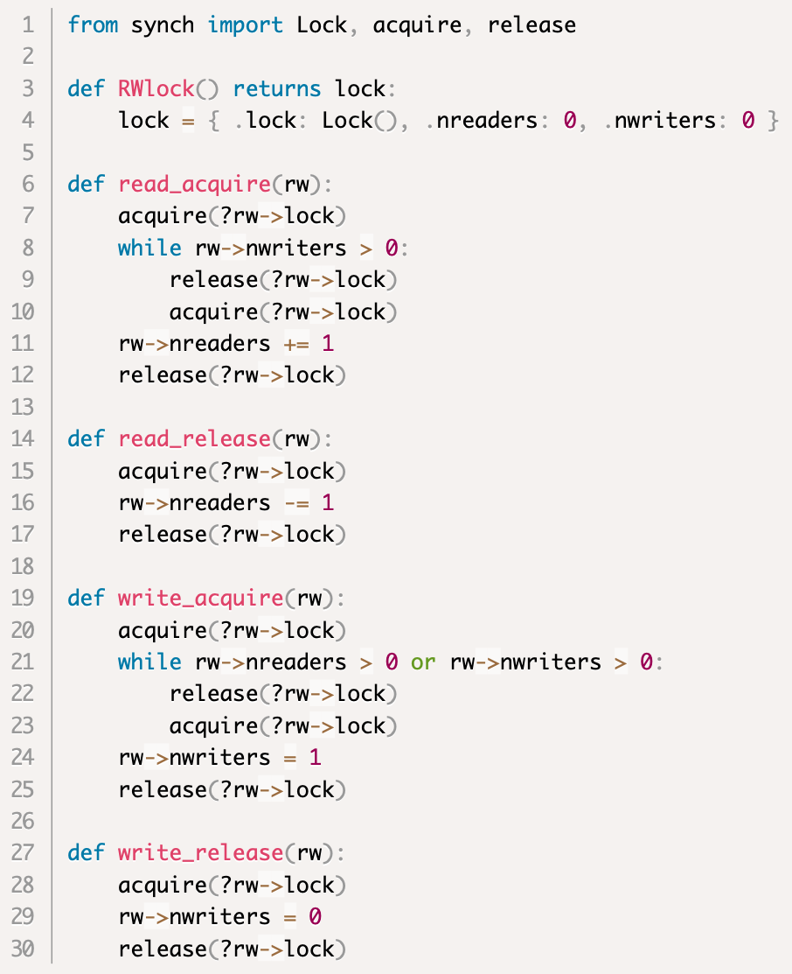
Busy Waiting Implementation

Slide 180
Busy Waiting Implementation
The lock protects nreaders and nwriters, not the critical section of the application

Slide 181
Busy Waiting Implementation
waiting conditions

Slide 182
Busy Waiting Implementation
Good: has the same behaviors as the implemention
Bad: process is continuously scheduled to try to get the lock even if it’s not available
(Harmony complains about this as well)

Slide 183
Mesa Condition Variables
A lock can have one or more condition variables
A thread that holds the lock but wants to wait for some condition to hold can temporarily release the lock by waiting on some condition variable
Associate a condition variable with each “waiting condition”
reader: no writer in the critical section
writer: no readers nor writers in the c.s.

Slide 184
Mesa Condition Variables, cont’d
When a thread that holds the lock notices that some waiting condition is satisfied it should notify the corresponding condition variable

Slide 185
R/W lock with Mesa condition variables
r_cond: used by readers to wait on nwriters == 0
w_cond: used by writers to wait on nreaders == 0 == nwriters

Slide 186
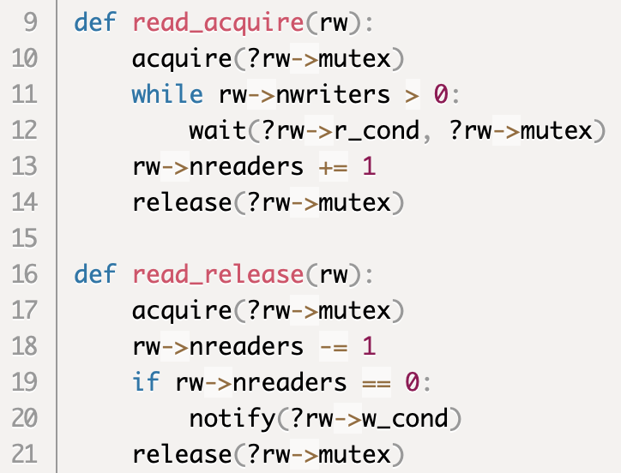
R/W Lock, reader part

Slide 187
R/W Lock, reader part
similar to busy waiting

Slide 188
R/W Lock, reader part
similar to busy waiting
but need this

Slide 189
R/W Lock, reader part
similar to busy waiting
Always use while
Never just if (or nothing)
wait without while is called a “naked wait”
but need this

Slide 190
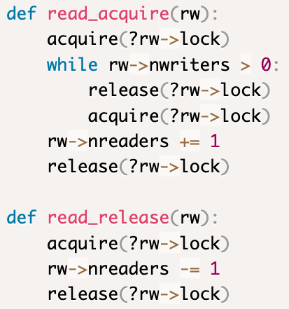
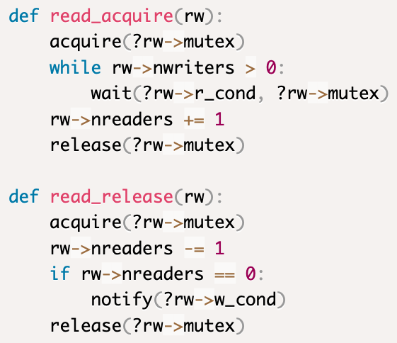
R/W Lock, reader part
compare with busy waiting

Slide 191
R/W Lock, reader part
compare with busy waiting

Slide 192
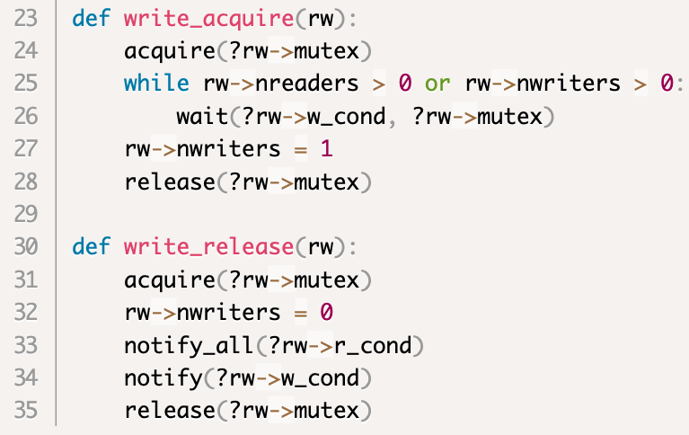
R/W Lock, writer part
don’t forget anybody!

Slide 193
Condition Variable interface
wait(cv, lock)
may only be called while holding lock
temporarily releases lock
but re-acquires it before resuming
if cv not notified, may block indefinitely
but wait() may resume ”on its own”
notify(cv)
no-op if nobody is waiting on cv
otherwise wakes up at least one thread waiting on cv
notify_all(cv)
wakes up all threads currently waiting on cv

Slide 194
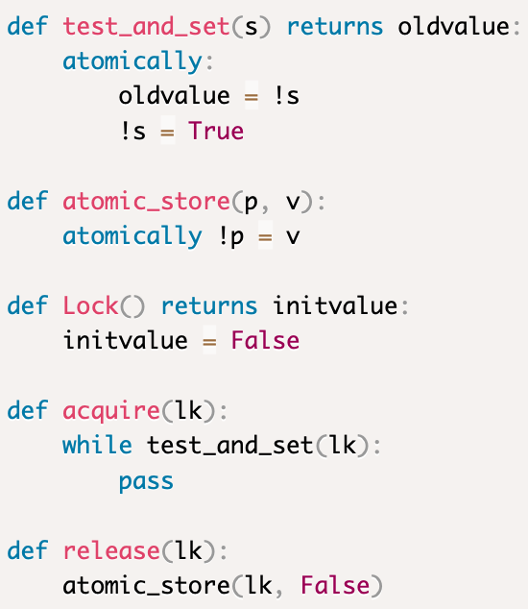
Busy Waiting or?

Slide 195
Busy Waiting or?

Slide 196
Busy Waiting or?
State unchanged while condition does not hold. This thread only “observes” the state until condition holds
State conditionally changes while condition does not hold. This thread actively changes the state until the condition hold

Slide 197
Busy Waiting or?
Busy Waiting
State unchanged while condition does not hold. This thread only “observes” the state until condition holds
State conditionally changes while condition does not hold. This thread actively changes the state until the condition hold

Slide 198
Why is busy waiting bad?
Consider a timesharing setting
Threads T1 and T2 take turns on the CPU
switch every 100 milliseconds
Suppose T1 has the lock and is running
Now suppose a clock interrupt occurs, T2 starts running and tries to acquire the lock
Non-busy-waiting acquisition:
T2 is put on a waiting queue and T1 resumes and runs until T1 releases the lock (which puts T2 back on the run queue)
Busy-waiting acquisition:
T2 keeps running (wasting CPU) until the lock is available until the next clock interrupt
T1 and T2 switch back and forth until T1 releases the lock

Slide 199
Busy Waiting vs Condition Variables
Busy Waiting | Condition Variables
Use a lock and a loop | Use a lock and a collection of condition variables and a loop
Easy to write the code | Notifying is tricky
Easy to understand the code | Easy to understand the code
Progress property is easy | Progress requires careful consideration (both for correctness and efficiency)
Ok-ish for true multi-core, but bad for virtual threads | Good for both multi-core and virtual threading

Slide 200
Busy Waiting: just don’t do it

Slide 201
Why no naked waits? (reason 1)
By the time waiter gets the lock back, condition may no longer hold
Given three threads, W1, R2, W3
W1 enters as a writer
R2 waits as a reader
W1 leaves, notifying R2
W3 enters as a writer
R2 wakes up
If R2 doesn’t check condition again, R2 and W3 would both be in the critical section

Slide 202
Why no naked waits? (reason 2)
When notifying, be safe rather than sorry
it’s better to notify too many threads than too few
in case of doubt, use notify_all() instead of just notify()
But this too can lead to some threads waking up when their condition is no longer satisfied

Slide 203
Why no naked waits? (reason 3)
Because you should use while around wait, many condition variable implementations allow “spurious wakeups”
wait() resumes even though condition variable was not notified

Slide 204
Naked waits: just don’t do it

Slide 205
Hints for reducing unneeded wakeups
Use separate condition variables for each waiting condition
Don’t use notify_all when notify suffices
but be safe rather than sorry
sometimes you can even use N calls to notify if you know at most N nodes can continue after a waiting condition holds

Slide 206
Deadlock

Slide 207
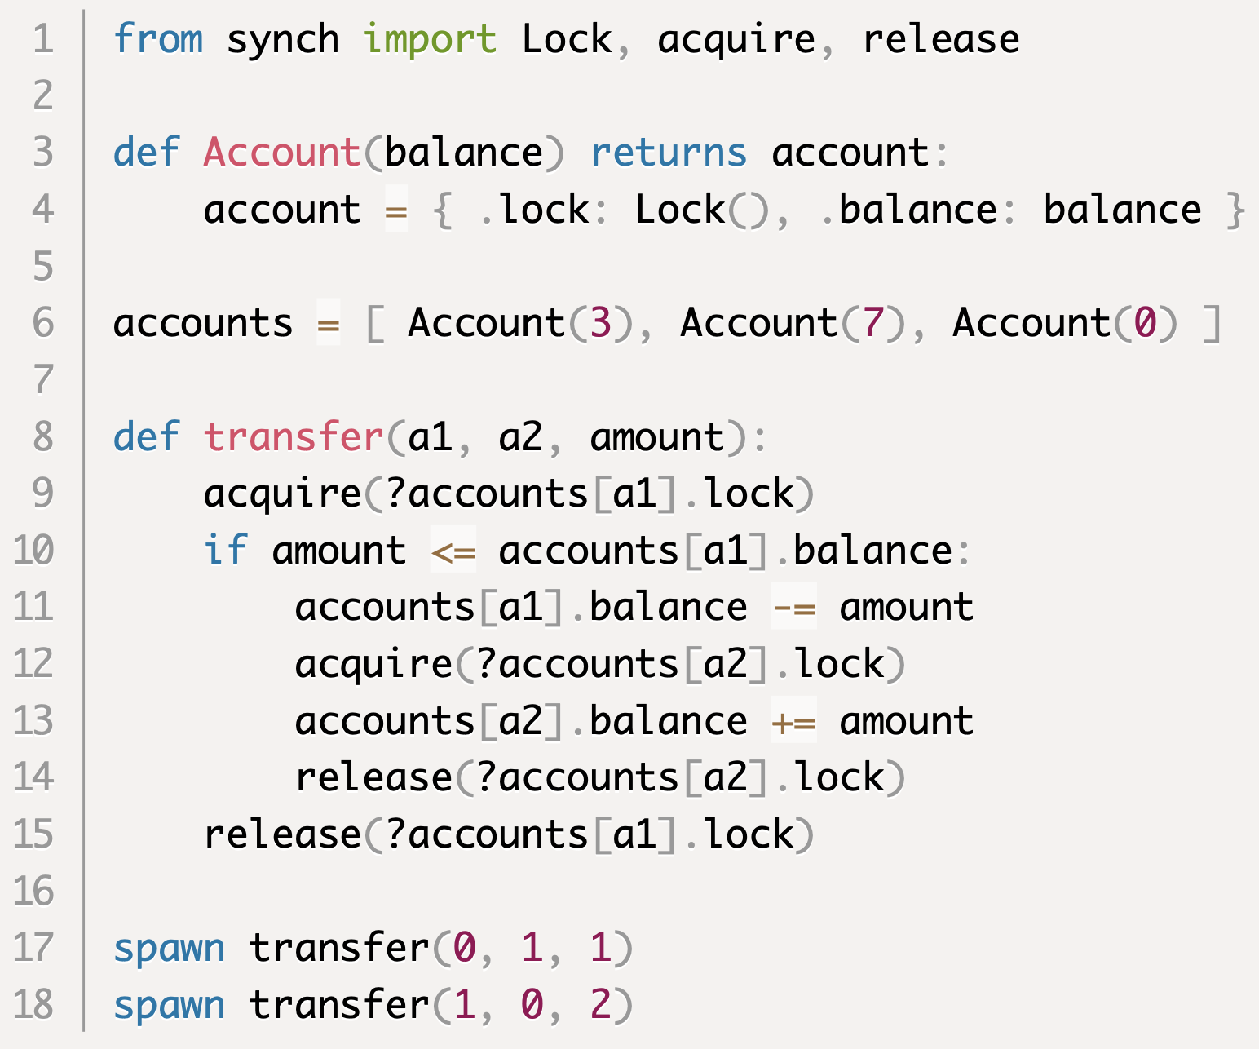
Deadlock example
What could go wrong?

Slide 208
Harmony output
Summary: some execution cannot terminate
Schedule thread T0: init()
Line 6: Set accounts to [ { "balance": 3, "lock": False }, { "balance": 7, "lock": False } ]
Schedule thread T1: transfer(0, 1, 1)
Line synch/36: Set accounts[0]["lock"] to True (was False)
Line 11: Set accounts[0]["balance"] to 2 (was 3)
Preempted in transfer(0, 1, 1) --> acquire(?accounts[1]["lock"])
Schedule thread T2: transfer(1, 0, 2)
Line synch/36: Set accounts[1]["lock"] to True (was False)
Line 11: Set accounts[1]["balance"] to 5 (was 7)
Preempted in transfer(1, 0, 2) --> acquire(?accounts[0]["lock"])
Final state (all threads have terminated or are blocked):
Threads:
T1: (blocked) transfer(0, 1, 1) --> acquire(?accounts[1]["lock"])
T2: (blocked) transfer(1, 0, 2) --> acquire(?accounts[0]["lock"])
Variables:
accounts: [ { "balance": 2, "lock": True }, { "balance": 5, "lock": True } ]

Slide 209
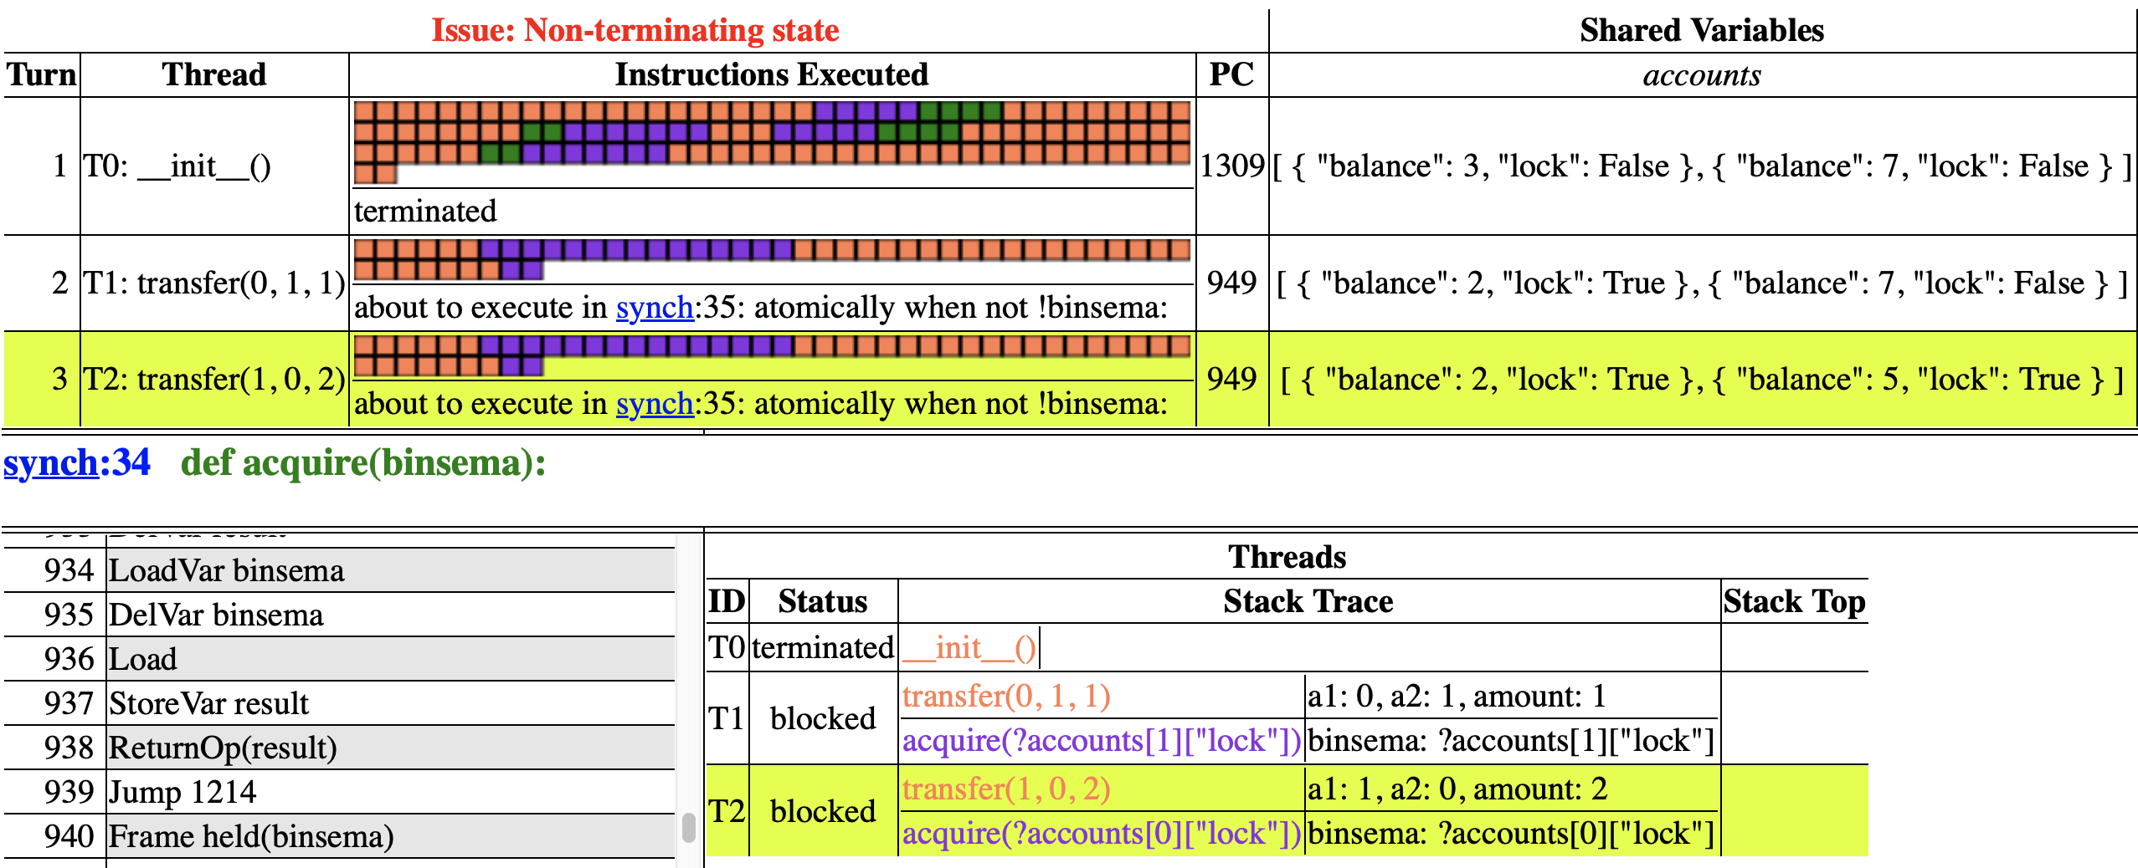
Harmony HTML Output

Slide 210
Deadlock vs Starvation
Starvation: some processes can run in theory, but the scheduler continually selects other processes to run first. Tied to fairness in scheduling.
Deadlock: no process can run because all are waiting for another process to change the state. The scheduler can’t help you now.

Slide 211
Deadlock vs Livelock
Livelock: some processes continually change their state but don’t make progress (like polite people trying to pass one another in a narrow hallway). The scheduler could fix this in theory.
Deadlock: no process can run because all are waiting for another process to change the state. The scheduler can’t help you now.

Slide 212
System Model
Collection of resources and threads
Examples of resources: I/O devices, GPUs, locks, buffers, slots in a buffer, …
Exclusive access
Only one thread can use a resource at a time
Protocol:
Thread acquires resource
thread is blocked until resource is free
Thread holds the resource
resource is allocated (not free) at this time
Thread releases the resource

Slide 213
Necessary Conditions for Deadlock
Edward Coffman 1971
Mutual Exclusion
acquire() can block invoker until resource is free
Hold & wait
A thread can be blocked while holding resources
No preemption
Allocated resources cannot be reclaimed
Circular wait
Let T_{i} → T_{j} denote “T_{i} waits for T_{j} to release a resource”.
Then $∃\text{T}\text{1}$, … T_{n} : T₁ → T₂ → … → T_{n} → T₁

Slide 214
Example: Mutual Exclusion
Mutual exclusion
Mutual exclusion

Slide 215
Example: Hold & Wait
Thread holds a1.lock
Threads wants a2.lock

Slide 216
Example: No Preemption
Only holder can release lock

Slide 217
Example: Circular Wait
Circular wait conditions

Slide 218
Three ways to deal with deadlock
Prevention: Programmer ensures that at least one of the necessary conditions cannot hold
Avoidance: Scheduler avoids deadlock scenarios (for example, by executing one thread at a time)
Detect and Recover: Allow deadlocks to happen. Detect them and recover in some way

Slide 219
Deadlock Prevention

Slide 220
Negate one of the following:
Mutual Exclusion
Hold & wait
No preemption
Circular wait

Slide 221
1. Negate Mutual Exclusion
Make resources sharable without locks
Non-blocking concurrent data structures
See Harmony book for examples
Have sufficient resources available so acquire() never blocks
make sure bounded buffer is large enough

Slide 222
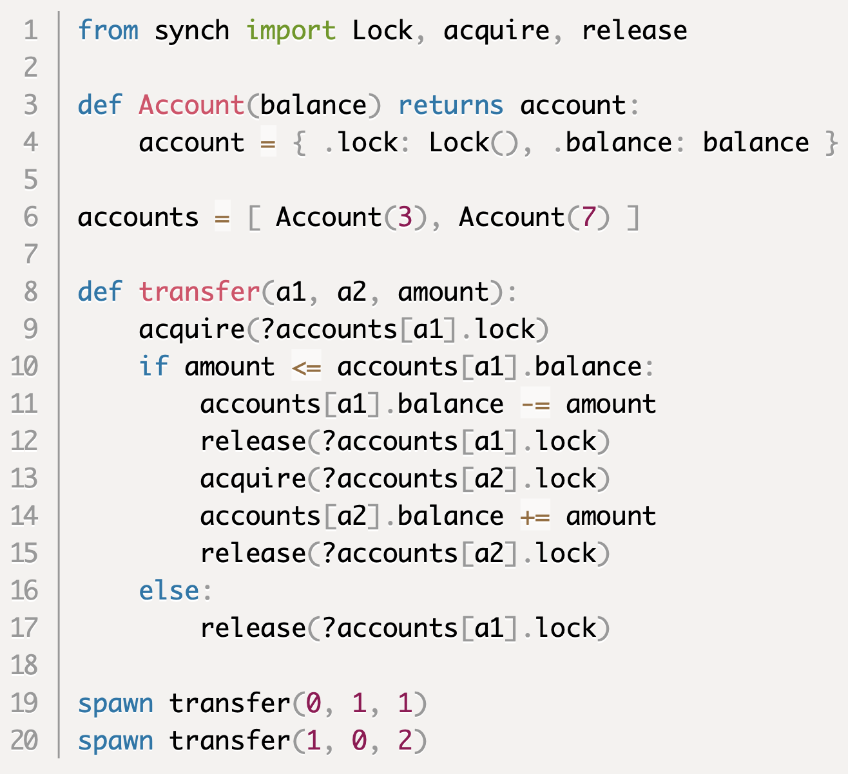
2. Negate Hold & Wait
Release resource before acquiring another

Slide 223
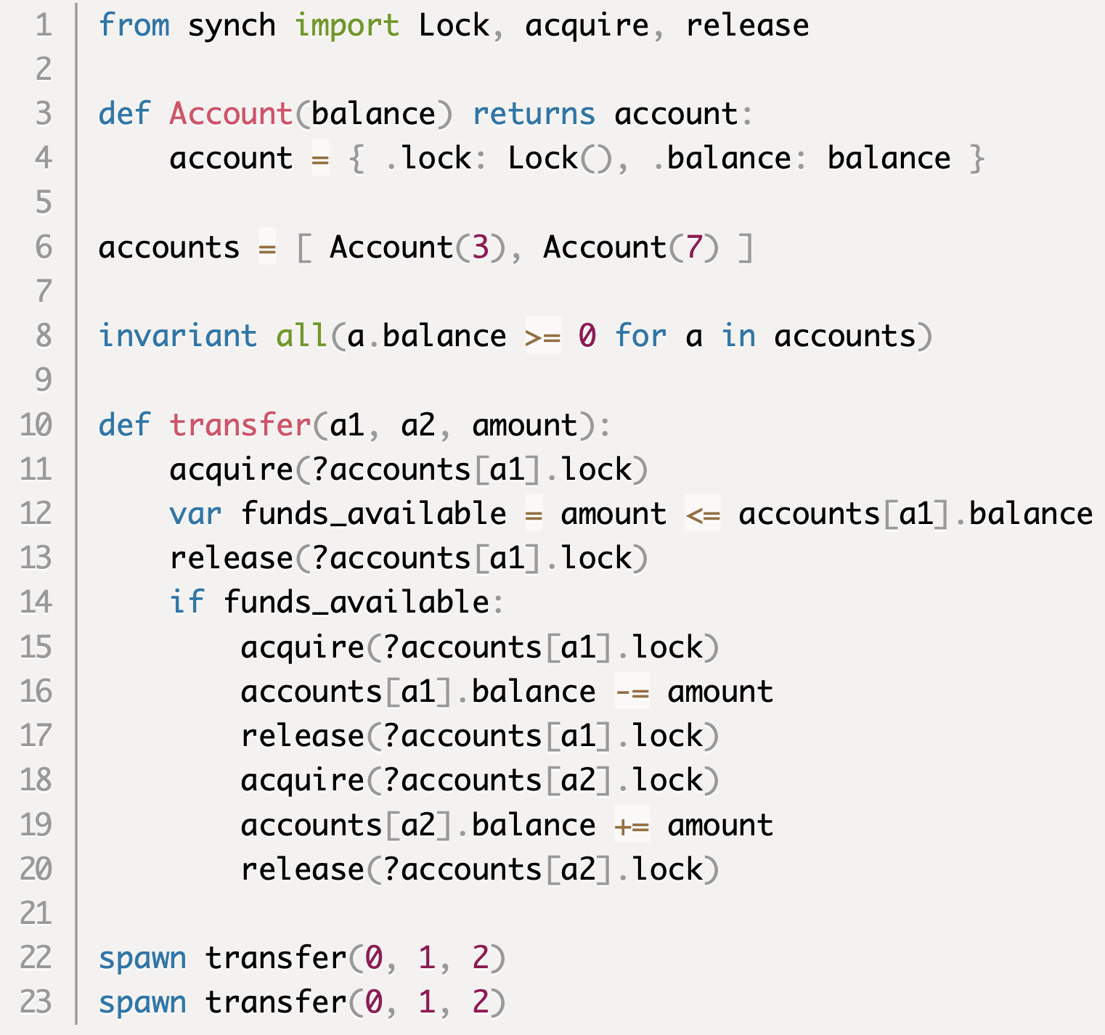
2: Negate Hold & Wait, badly
check if funds are available
withdraw funds from a1
deposit funds for a2
What could go wrong?

Slide 224
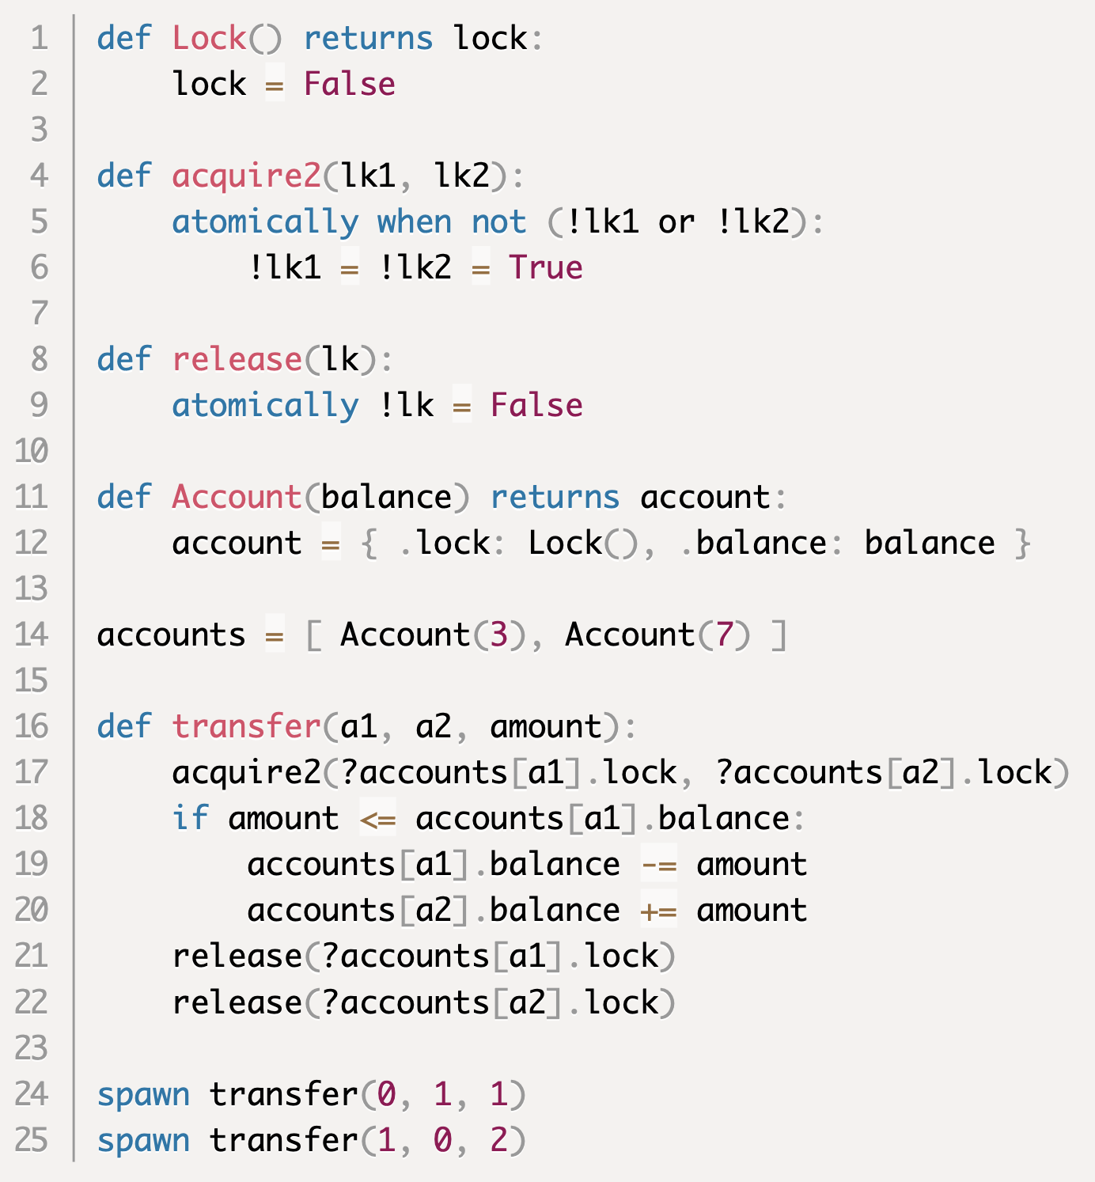
2. Negate Hold & Wait, alternate
Spec: Acquire two locks
Acquire resources at the same time

Slide 225
3. Allow Preemption
Time-multiplexing of resources
threads: context switching
memory: paging
Database transactions
2-phase locking + transaction abort and retry

Slide 226
4: Negate circular wait
Define a total order on resources
Rule: a thread cannot acquire a resource that is “lower” than a resource already held
Either:
a thread is careful to acquire resources that it needs in order, or
a thread that wants to acquire a resource R must first release all resources that are lower than R

Slide 227
Why does resource ordering work?
Theorem: Resource ordering prevents circular wait
Proof by contradiction:
Assume circular wait exists
$∃\text{T}\text{1}$, … T_{n} : T₁ → T₂ → … → T_{n} → T₁
T_{i} requests R_{j} held by T_{j} ($j=\left(i+1\right) mod n)$
Resource ordering: R₁ < R₂ , …, R_{n-1} < R_{n} , R_{n} < R₁
R₁ < R₁
Violates irreflexivity of total order

Slide 228
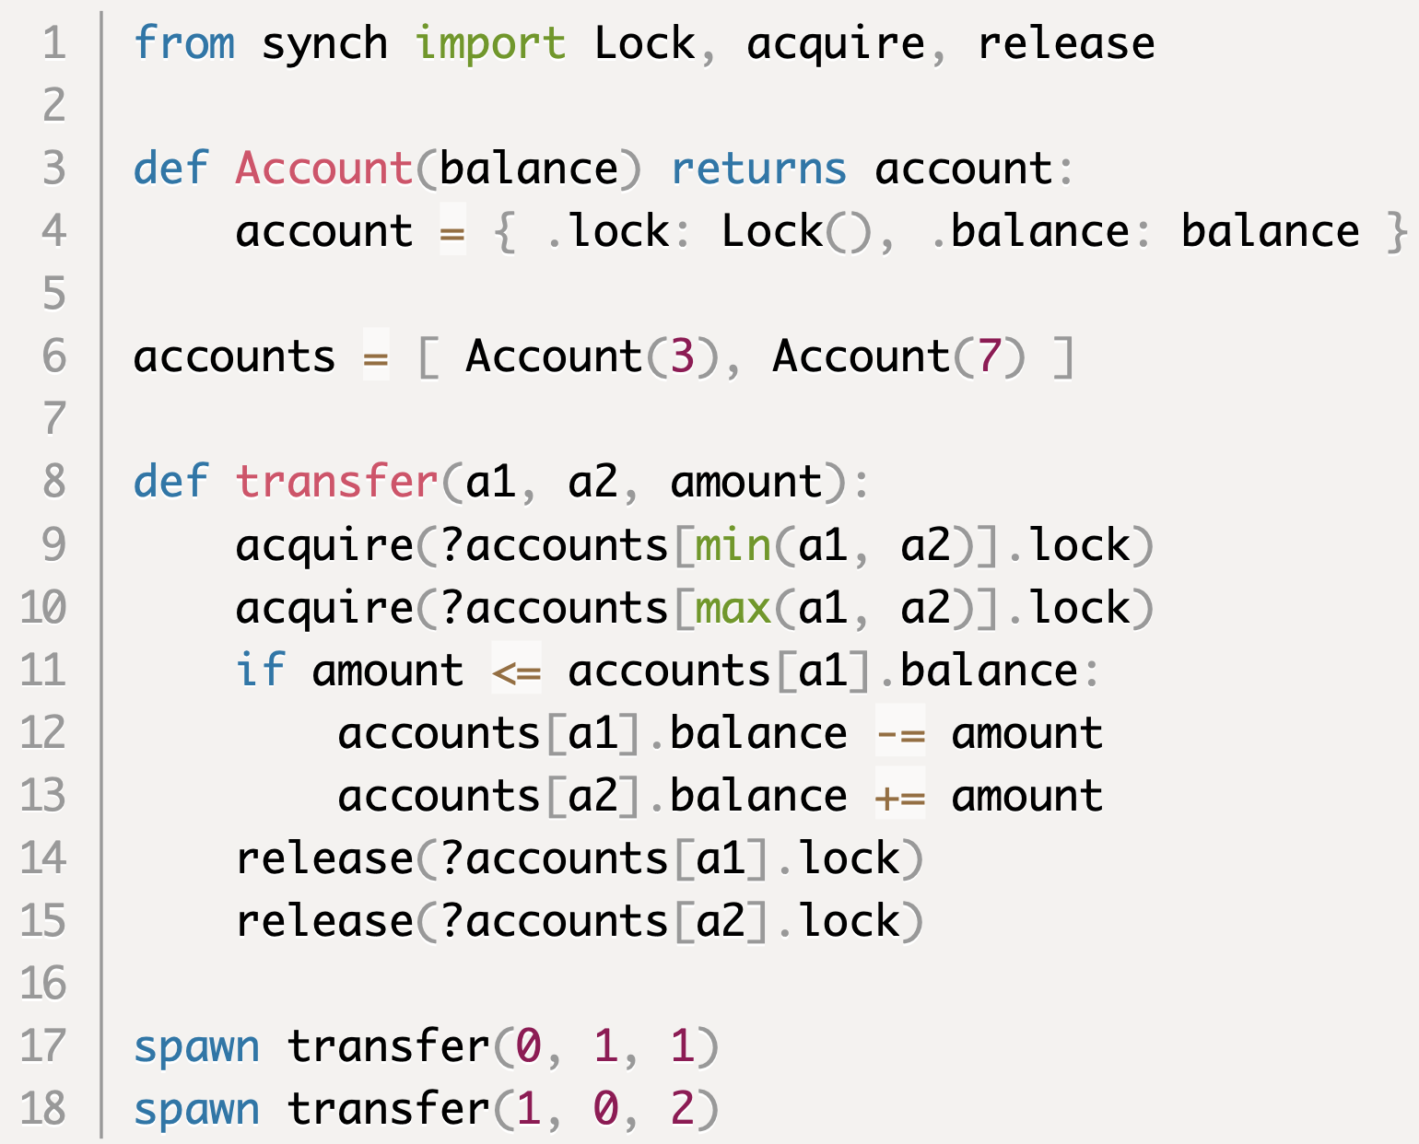
4: Negate circular wait
Acquire resources in order

Slide 229
Deadlock Avoidance

Slide 230
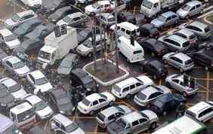
Deadlock in traffic
How can these be avoided?

Slide 231
Deadlock Avoidance
Scheduler carefully schedules threads so deadlock cannot occur
For example, it might allow only one thread to run at a time, to completion
This is extreme: no concurrency
Better solutions typically require that the scheduler has some abstract knowledge of what the threads are trying to accomplish

Slide 232
Safe States
A state is an allocation of resources to threads
The state changes each time a thread allocates or releases a resource
A safe state is a state from which an execution exists that does not cause deadlock
Notes:
the initial state is safe: threads can be scheduled one at a time
an unsafe state is not necessarily deadlocked, but deadlock is unavoidable
deadlock may be possible from a safe state, but it is avoidable through careful scheduling

Slide 233
Deadlock Avoidance
Scheduler should only allow safe states to happen in an execution
When a thread tries to acquire() a resource, the scheduler should block the thread, if acquiring the resource leads to an unsafe state, until this is no longer the case
release() is always ok

Slide 234
Deadlock Avoidance
How?

Slide 235
Deadlock Avoidance
For example, don’t schedule two threads transfer($a1$, $a2$) and transfer($a3$, $a4$) at the same time unless $\left\{ a1, a2 \right\}∩\left\{a3, a4\right\}= ∅$

Slide 236
Avoidance specified in Harmony
keep track of which accounts are active
enforce no intersection with active transfers
update scheduler state

Slide 237
Deadlock Detection and Recovery

Slide 238
Deadlock Detection
Keep track of allocation of resources to threads
Resources
Threads

Slide 239
Deadlock Detection
Keep track of allocation of resources to threads
Keep track of which threads are trying to acquire which resource
Resources
Threads

Slide 240
Deadlock Detection
Known as the Resource Allocation Graph
Deadlock $≡$ cycle in the graph
Resources
Threads

Slide 241
Deadlock Detection
Known as the Resource Allocation Graph
Deadlock $≡$ cycle in the graph
Resources
Threads

Slide 242
Finding Cycles
Graph Reduction Algorithm:
While there are nodes with no outgoing edges
select one such node
remove node and its incoming edges
If the graph empty (no nodes), then no cycles
No cycles $⟹$ No deadlock

Slide 243
Deadlock Detection
Deadlock detection is expensive
When to run graph reduction?
When a resource request cannot be granted?
When a thread has been blocked for a certain amount of time?
Periodically?

Slide 244
Deadlock Recovery Strategies
Blue screen and reboot
Can lose data / results of long computations
Deny a request to remove cyle
Programmer responsible for exception
Kill processes until cycle is gone
Can lose data / results of long computations
Select processes that have been running shortest amount of time
Use transactions to access resources
Abort and retry transaction if deadlock exists
Requires roll-back or versioning of state

Slide 245
Actors
[Robbert van Renesse]

Slide 246
Actor Model
An actor is a type of process
Each actor has an incoming message queue
No other shared state
Actors communicate by “message passing”
placing messages on message queues
Supports modular concurrent programs
Actors and message queues are abstractions

Slide 247
Mutual Exclusion with Actors
Data structure owned by a “server actor”
Client actors can send request messages to the server and receive response messages if necessary
Server actor awaits requests on its queue and executes one request at a time
➔
Mutual Exclusion (one request at a time)
Progress (requests eventually get to the head of the queue)
Fairness (requests are handled in FCFS order)
actor 1
actor 3
actor 2

Slide 248
Conditional Critical Sections with Actors
An actor can “wait” for a condition by waiting for a specific message
An actor can “notify” another actor by sending it a message

Slide 249
Parallel processing with Actors
Organize program with a Manager Actor and a collection of Worker Actors
Manager Actor sends work requests to the Worker Actors
Worker Actors send completion requests to the Manager Actor
worker 1
worker 2
head
worker 3
worker 4
worker 5

Slide 250
Parallel processing example

Slide 251
Pipeline Parallelism with Actors
Organize program as a chain of actors
For example, REST/HTTP server
Network receive actor → HTTP parser actor → REST request actor → Application actor → REST response actor → HTTP response actor → Network send actor
actor 1
actor 2
actor 3
automatic flow control (when actors run at different rates)
with bounded buffer queues

Slide 252
Pipelining Example
Find Mersenne primes

Slide 253
Support for actors in programming languages
Native support in languages such as Scala and Erlang
”blocking queues” in Python, Harmony, Java
Actor support libraries for Java, C, …
Actors also nicely generalize to distributed systems!

Slide 254
Actor disadvantages?
Doesn’t work well for “fine-grained” synchronization
overhead of message passing much higher than lock/unlock
Sending/receiving messages just to access a data structure leads to significant extra code

Slide 255
Barrier Synchronization

Slide 256
Barrier Synchronization: the opposite of mutual exclusion…
Set of processes run in rounds
Must all complete a round before starting the next
Popular in simulation, HPC, graph processing, model checking…
Lock-based synchronization reduces opportunities for parallelism
Barrier Synchronization supports scalable parallelism

Slide 257
Barrier abstraction
Barrier(N): barrier for N threads
bwait(): start the next round

Slide 258
Example: dot product

Slide 259
Test program for barriers
work done before barrier
work done after barrier

Slide 260
Test program for barriers
no one can pass barrier until all reached the barrier
work done before barrier
work done after barrier

Slide 261
Barrier Specification, Attempt 1
State:
required: #threads
n: #threads that have reached the barrier

Slide 262
Barrier Specification, Attempt 1
State:
required: #threads
n: #threads that have reached the barrier
turnstile

Slide 263
Barrier Specification, Attempt 1
State:
required: #threads
n: #threads that have reached the barrier
turnstile
waiting area

Slide 264
Barrier Specification, Attempt 1
State:
required: #threads
n: #threads that have reached the barrier
Only works one round

Slide 265
Barrier Specification, Attempt 2

Slide 266
Barrier Specification, Attempt 2
Still only works once

Slide 267
Barrier Specification, Attempt 3

Slide 268
Barrier Specification, Attempt 3
Works, but double
waiting is inefficient

Slide 269
Barrier Specification, final version
State:
required: #threads
n: #threads that have reached the barrier
color: allows re-use of barrier. Flipped each round

Slide 270
Barrier Implementation

Slide 271
Advanced Barrier Synchronization
Given is a resource of finite capacity
Bus with N seats, say
Resource must be used at full capacity
Bus won’t go until it is full
Resource must be completed emptied before it can be re-used
Everybody must get off at destination before anybody can get back on the bus

Slide 272
Advanced Barrier Synchronization
Given is a resource of finite capacity
Bus with N seats, say
Resource must be used at full capacity
Bus won’t go until it is full
Resource must be completed emptied before it can be re-used
Everybody must get off at destination before anybody can get back on the bus
Typical Exam Question!

Slide 273
Interface
enter(resource)
must wait if resource is in use or if resource has not yet been fully unloaded
after that, must wait until resource is full
exit(resource)
any time

Slide 274
Rounds and Phases
Round: each time the resource gets used
Three phases in each round:
Resource is loaded
Resource is used
Resource is unloaded
Two waiting conditions:
Wait until resource is fully unloaded
Before starting to load the resource
Wait until resource is fully loaded
Before starting to use the resource

Slide 275
Rollercoaster
JOE MCBRIDE / GETTY IMAGES

Slide 276
Interrupt Safety

Slide 277
Interrupt handling
When executing in user space, a device interrupt is invisible to the user process
State of user process is unaffected by the device interrupt and its subsequent handling
This is because contexts are switched back and forth
So, the user space context is exactly restored to the state it was in before the interrupt

Slide 278
Interrupt handling
However, there are also “in-context” interrupts:
kernel code can be interrupted
user code can handle “signals”
→ Potential for race conditions

Slide 279
“Traps” in Harmony
check count == 1 in the final state
invoke handler() at some future time
Within the same thread!
($trap ≠spawn$)

Slide 280
But what now?

Slide 281
But what now?

Slide 282
Locks to the rescue?

Slide 283
Locks to the rescue?

Slide 284
Enabling/disabling interrupts
disable interrupts
enable interrupts

Slide 285
Interrupt-Safe Methods
disable interrupts
restore old interrupt level

Slide 286
Interrupt-safe AND Thread-safe?

Slide 287
Interrupt-safe AND Thread-safe?
wait for own interrupt

Slide 288
Interrupt-safe AND Thread-safe?
first disable interrupts
wait for own interrupt

Slide 289
Interrupt-safe AND Thread-safe?
first disable interrupts
then acquire a lock
wait for own interrupt

Slide 290
Interrupt-safe AND Thread-safe?
why 4?
first disable interrupts
then acquire a lock
wait for own interrupt

Slide 291
Warning: very few C functions are interrupt-safe
pure system calls are interrupt-safe
e.g. read(), write(), etc.
functions that do not use global data are interrupt-safe
e.g. strlen(), strcpy(), etc.
malloc() and free() are not interrupt-safe
printf() is not interrupt-safe
However, all these functions are thread-safe

